Slide 1
Chapter 12. Outlier Analysis
Outlier and Outlier Analysis
Outlier Detection Methods
Statistical Approaches
Proximity-Base Approaches
Clustering-Base Approaches
Classification Approaches
Mining Contextual and Collective Outliers
Outlier Detection in High Dimensional Data
Summary

Slide 2

What Are Outliers?
Outlier: A data object that deviates significantly from the normal objects as if it were generated by a different mechanism
  Ex.: Unusual credit card purchase, sports: Michael Jordon, Wayne Gretzky, ...
Outliers are different from the noise data
  Noise is random error or variance in a measured variable
  Noise should be removed before outlier detection
Outliers are interesting: It violates the mechanism that generates the normal data
Outlier detection vs. novelty detection: early stage, outlier; but later merged into the model
Applications:
  Credit card fraud detection
  Telecom fraud detection
  Customer segmentation
  Medical analysis

Slide 3
Types of Outliers (I)
Three kinds: global, contextual and collective outliers
Global outlier (or point anomaly)
  Object is O_{g} if it significantly deviates from the rest of the data set
  Ex. Intrusion detection in computer networks
  Issue: Find an appropriate measurement of deviation
Contextual outlier (or conditional outlier)
  Object is O_{c} if it deviates significantly based on a selected context
  Ex. 80º F in Urbana: outlier? (depending on summer or winter?)
  Attributes of data objects should be divided into two groups
    Contextual attributes: defines the context, e.g., time & location
    Behavioral attributes: characteristics of the object, used in outlier evaluation, e.g., temperature
  Can be viewed as a generalization of local outliers—whose density significantly deviates from its local area
  Issue: How to define or formulate meaningful context?
Global Outlier

Slide 4

Types of Outliers (II)
Collective Outliers
  A subset of data objects collectively deviate significantly from the whole data set, even if the individual data objects may not be outliers
  Applications: E.g., intrusion detection:
    When a number of computers keep sending denial-of-service packages to each other
Collective Outlier
  Detection of collective outliers
    Consider not only behavior of individual objects, but also that of groups of objects
    Need to have the background knowledge on the relationship among data objects, such as a distance or similarity measure on objects.
A data set may have multiple types of outlier
One object may belong to more than one type of outlier

Slide 5
Challenges of Outlier Detection
Modeling normal objects and outliers properly
  Hard to enumerate all possible normal behaviors in an application
  The border between normal and outlier objects is often a gray area
Application-specific outlier detection
  Choice of distance measure among objects and the model of relationship among objects are often application-dependent
  E.g., clinic data: a small deviation could be an outlier; while in marketing analysis, larger fluctuations
Handling noise in outlier detection
  Noise may distort the normal objects and blur the distinction between normal objects and outliers. It may help hide outliers and reduce the effectiveness of outlier detection
Understandability
  Understand why these are outliers: Justification of the detection
  Specify the degree of an outlier: the unlikelihood of the object being generated by a normal mechanism

Slide 6
Chapter 12. Outlier Analysis
Outlier and Outlier Analysis
Outlier Detection Methods
Statistical Approaches
Proximity-Base Approaches
Clustering-Base Approaches
Classification Approaches
Mining Contextual and Collective Outliers
Outlier Detection in High Dimensional Data
Summary

Slide 7
Outlier Detection I: Supervised Methods
Two ways to categorize outlier detection methods:
  Based on whether user-labeled examples of outliers can be obtained:
    Supervised, semi-supervised vs. unsupervised methods
  Based on assumptions about normal data and outliers:
    Statistical, proximity-based, and clustering-based methods
Outlier Detection I: Supervised Methods
  Modeling outlier detection as a classification problem
    Samples examined by domain experts used for training & testing
  Methods for Learning a classifier for outlier detection effectively:
    Model normal objects & report those not matching the model as outliers, or
    Model outliers and treat those not matching the model as normal
  Challenges
    Imbalanced classes, i.e., outliers are rare: Boost the outlier class and make up some artificial outliers
    Catch as many outliers as possible, i.e., recall is more important than accuracy (i.e., not mislabeling normal objects as outliers)

Slide 8
Outlier Detection II: Unsupervised Methods
Assume the normal objects are somewhat ``clustered'‘ into multiple groups, each having some distinct features
An outlier is expected to be far away from any groups of normal objects
Weakness: Cannot detect collective outlier effectively
  Normal objects may not share any strong patterns, but the collective outliers may share high similarity in a small area
Ex. In some intrusion or virus detection, normal activities are diverse
  Unsupervised methods may have a high false positive rate but still miss many real outliers.
  Supervised methods can be more effective, e.g., identify attacking some key resources
Many clustering methods can be adapted for unsupervised methods
  Find clusters, then outliers: not belonging to any cluster
  Problem 1: Hard to distinguish noise from outliers
  Problem 2: Costly since first clustering: but far less outliers than normal objects
    Newer methods: tackle outliers directly

Slide 9
Outlier Detection III: Semi-Supervised Methods
Situation: In many applications, the number of labeled data is often small: Labels could be on outliers only, normal objects only, or both
Semi-supervised outlier detection: Regarded as applications of semi-supervised learning
If some labeled normal objects are available
  Use the labeled examples and the proximate unlabeled objects to train a model for normal objects
  Those not fitting the model of normal objects are detected as outliers
If only some labeled outliers are available, a small number of labeled outliers many not cover the possible outliers well
  To improve the quality of outlier detection, one can get help from models for normal objects learned from unsupervised methods

Slide 10
Outlier Detection (1): Statistical Methods
Statistical methods (also known as model-based methods) assume that the normal data follow some statistical model (a stochastic model)
  The data not following the model are outliers.
Example (right figure): First use Gaussian distribution to model the normal data
  For each object y in region R, estimate g_{D}(y), the probability of y fits the Gaussian distribution
  If g_{D}(y) is very low, y is unlikely generated by the Gaussian model, thus an outlier
Effectiveness of statistical methods: highly depends on whether the assumption of statistical model holds in the real data
There are rich alternatives to use various statistical models
  E.g., parametric vs. non-parametric

Slide 11
Outlier Detection (2): Proximity-Based Methods
An object is an outlier if the nearest neighbors of the object are far away, i.e., the proximity of the object is significantly deviates from the proximity of most of the other objects in the same data set
Example (right figure): Model the proximity of an object using its 3 nearest neighbors
  Objects in region R are substantially different from other objects in the data set.
  Thus the objects in R are outliers
The effectiveness of proximity-based methods highly relies on the proximity measure.
In some applications, proximity or distance measures cannot be obtained easily.
Often have a difficulty in finding a group of outliers which stay close to each other
Two major types of proximity-based outlier detection
  Distance-based vs. density-based

Slide 12
Outlier Detection (3): Clustering-Based Methods
Normal data belong to large and dense clusters, whereas outliers belong to small or sparse clusters, or do not belong to any clusters
Example (right figure): two clusters
  All points not in R form a large cluster
  The two points in R form a tiny cluster, thus are outliers
Since there are many clustering methods, there are many clustering-based outlier detection methods as well
Clustering is expensive: straightforward adaption of a clustering method for outlier detection can be costly and does not scale up well for large data sets

Slide 13
Chapter 12. Outlier Analysis
Outlier and Outlier Analysis
Outlier Detection Methods
Statistical Approaches
Proximity-Base Approaches
Clustering-Base Approaches
Classification Approaches
Mining Contextual and Collective Outliers
Outlier Detection in High Dimensional Data
Summary

Slide 14
Statistical Approaches
Statistical approaches assume that the objects in a data set are generated by a stochastic process (a generative model)
Idea: learn a generative model fitting the given data set, and then identify the objects in low probability regions of the model as outliers
Methods are divided into two categories: parametric vs. non-parametric
Parametric method
  Assumes that the normal data is generated by a parametric distribution with parameter θ
  The probability density function of the parametric distribution f(x, θ) gives the probability that object x is generated by the distribution
  The smaller this value, the more likely x is an outlier
Non-parametric method
  Not assume an a-priori statistical model and determine the model from the input data
  Not completely parameter free but consider the number and nature of the parameters are flexible and not fixed in advance
  Examples: histogram and kernel density estimation

Slide 15
Chapter 12. Outlier Analysis
Outlier and Outlier Analysis
Outlier Detection Methods
Statistical Approaches
Proximity-Base Approaches
Clustering-Base Approaches
Classification Approaches
Mining Contextual and Collective Outliers
Outlier Detection in High Dimensional Data
Summary

Slide 16
Proximity-Based Approaches: Distance-Based vs. Density-Based Outlier Detection
Intuition: Objects that are far away from the others are outliers
Assumption of proximity-based approach: The proximity of an outlier deviates significantly from that of most of the others in the data set
Two types of proximity-based outlier detection methods
  Distance-based outlier detection: An object o is an outlier if its neighborhood does not have enough other points
  Density-based outlier detection: An object o is an outlier if its density is relatively much lower than that of its neighbors

Slide 17
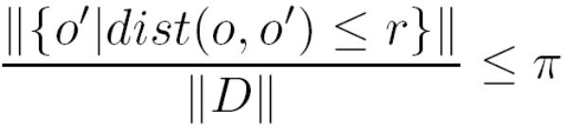

Distance-Based Outlier Detection
For each object o, examine the # of other objects in the r-neighborhood of o, where r is a user-specified distance threshold
An object o is an outlier if most (taking π as a fraction threshold) of the objects in D are far away from o, i.e., not in the r-neighborhood of o
An object o is a DB(r, π) outlier if
Equivalently, one can check the distance between o and its k-th nearest neighbor o_{k}, where . o is an outlier if dist(o, o_{k}) > r
Efficient computation: Nested loop algorithm
  For any object o_{i}, calculate its distance from other objects, and count the # of other objects in the r-neighborhood.
  If π∙n other objects are within r distance, terminate the inner loop
  Otherwise, o_{i} is a DB(r, π) outlier
Efficiency: Actually CPU time is not O(n²) but linear to the data set size since for most non-outlier objects, the inner loop terminates early

Slide 18
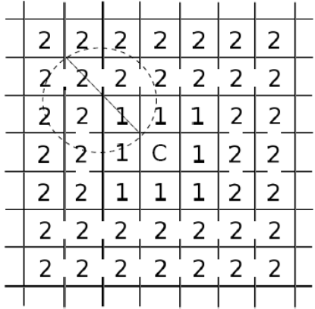
Distance-Based Outlier Detection: A Grid-Based Method
Why efficiency is still a concern? When the complete set of objects cannot be held into main memory, cost I/O swapping
The major cost: (1) each object tests against the whole data set, why not only its close neighbor? (2) check objects one by one, why not group by group?
Grid-based method (CELL): Data space is partitioned into a multi-D grid. Each cell is a hyper cube with diagonal length r/2
Pruning using the level-1 & level 2 cell properties:
  For any possible point x in cell C and any possible point y in a level-1 cell, dist(x,y) ≤ r
  For any possible point x in cell C and any point y such that dist(x,y) ≥ r, y is in a level-2 cell
Thus we only need to check the objects that cannot be pruned, and even for such an object o, only need to compute the distance between o and the objects in the level-2 cells (since beyond level-2, the distance from o is more than r)

Slide 19
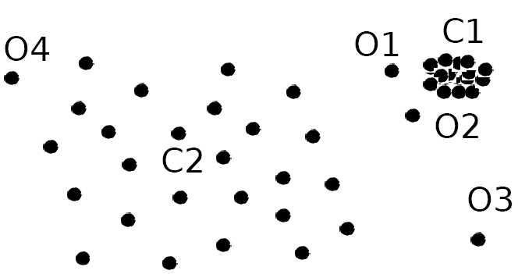
Density-Based Outlier Detection
Local outliers: Outliers comparing to their local neighborhoods, instead of the global data distribution
In Fig., o₁ and o2 are local outliers to C₁, o₃ is a global outlier, but o₄ is not an outlier. However, proximity-based clustering cannot find o₁ and o₂ are outlier (e.g., comparing with O₄).
Intuition (density-based outlier detection): The density around an outlier object is significantly different from the density around its neighbors
Method: Use the relative density of an object against its neighbors as the indicator of the degree of the object being outliers
k-distance of an object o, dist_{k}(o): distance between o and its k-th NN
k-distance neighborhood of o, N_{k}(o) = {o’| o’ in D, dist(o, o’) ≤ dist_{k}(o)}
  N_{k}(o) could be bigger than k since multiple objects may have identical distance to o

Slide 20
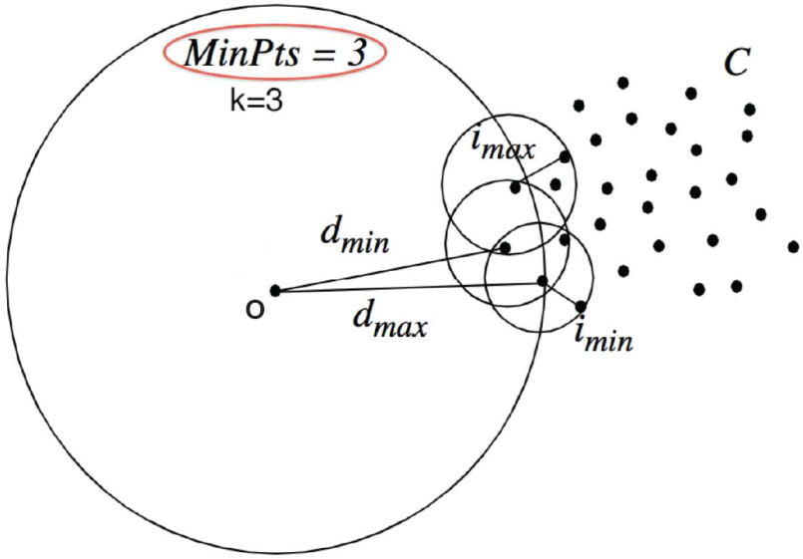
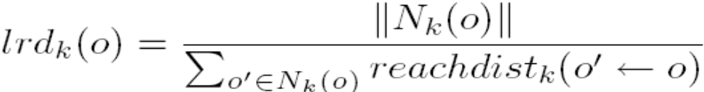
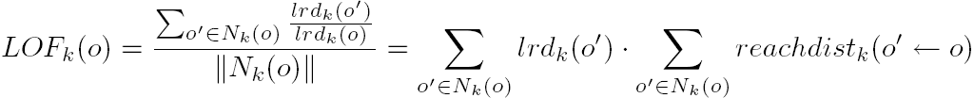
Local Outlier Factor: LOF
Reachability distance from o’ to o:
  where k is a user-specified parameter
Local reachability density of o:
LOF (Local outlier factor) of an object o is the average of the ratio of local reachability of o and those of o’s k-nearest neighbors
The lower the local reachability density of o, and the higher the local reachability density of the kNN of o, the higher LOF
This captures a local outlier whose local density is relatively low comparing to the local densities of its kNN

Slide 21
Chapter 12. Outlier Analysis
Outlier and Outlier Analysis
Outlier Detection Methods
Statistical Approaches
Proximity-Base Approaches
Clustering-Base Approaches
Classification Approaches
Mining Contextual and Collective Outliers
Outlier Detection in High Dimensional Data
Summary

Slide 22
Clustering-Based Method: Strength and Weakness
Strength
  Detect outliers without requiring any labeled data
  Work for many types of data
  Clusters can be regarded as summaries of the data
  Once the cluster are obtained, need only compare any object against the clusters to determine whether it is an outlier (fast)
Weakness
  Effectiveness depends highly on the clustering method used—they may not be optimized for outlier detection
  High computational cost: Need to first find clusters
  A method to reduce the cost: Fixed-width clustering
    A point is assigned to a cluster if the center of the cluster is within a pre-defined distance threshold from the point
    If a point cannot be assigned to any existing cluster, a new cluster is created and the distance threshold may be learned from the training data under certain conditions

